Slide 1



Mermaid
Resources Repository
Yannis Ioannidis, Professor
Evita Mailli
University of Athens
Dept. of Informatics & Telecom.
MaDgIK Lab

Slide 2
Overview
Updated url address - http://mermaid.madgik.di.uoa.gr.
Created metadata schema (Dublin Core).
Created automated feed to expose metadata to harvesters.
Partners can now create accounts and upload resources, and view private content.
Created new section (WP 8) to clearly identify resources needs.
Notes:
Data, Models, and Decisions. All relevant documents should be uploaded in the repository.

Slide 3
Structure – new section (WP 8)
Resources overview
  An overview of Mermaid’s available resources / results.
  Clear picture to partners and reviewers.
  Categories
  Cost-Benefit Analysis
  Environmental Impact Assessment
  Financial and Economic Assessment
  General resources

Slide 4
Structure – new section (WP 8)
Resources subcategories
  Produced inside Mermaid
  Produced outside Mermaid

Slide 5
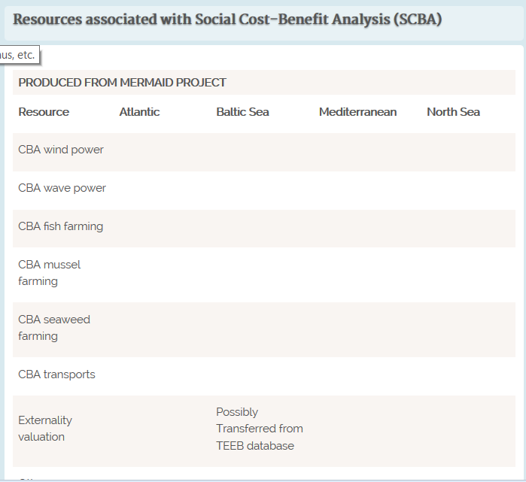
Resources overview – missing information

Slide 6
Policy recommendations
Partners - Sharing and re-use of the data (or metadata) of the participating resource providers.
  Last meeting: Questionnaire did not work as expected - assessing the datasets
  Conclusion: Initial Policy should be constructed and partners could follow that recommendation

Slide 7
Recommended policy
Heterogeneous Data
Multiple Providers
  Basic metadata schema: Dublin Core format
  Open Access Initiative (OAI) support to expose metadata to the community

Slide 8
Digital agenda for Europe – Open Data
“The Commission's work in the area of open data is focusing on generating value through re-use of a specific type of data – public sector information, sometimes also referred to as government data. That is all the information that public bodies produce, collect or pay for. Examples are: geographical information, statistics, weather data, data from publicly funded research projects, and digitized books from libraries.”
“The Commission funds the "LOD2 - Creating Knowledge out of Interlinked Data" project, which developed a prototype pan-European search portal, publicdata.eu. This harvests metadata information from existing open data portal sites in Europe and makes them searchable through a multi-lingual user interface.”

Slide 9
Open Archives Initiative
The Open Archives Initiative Protocol for Metadata Harvesting provides an application-independent interoperability framework based on metadata harvesting.
Data Providers administer systems that support the OAI-PMH as a means of exposing metadata;

Slide 10
Workflow for uploading/linking and describing your resources in dublin core.
Create an account on mermaid.madgik.di.uoa.gr/user/register
Confirm your email address
Visit mermaid.madgik.di.uoa.gr/user and log in

Slide 11
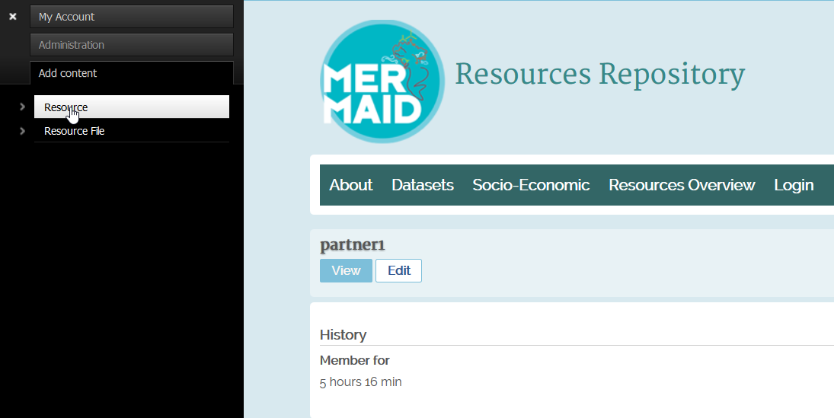
Workflow for uploading and describing your dataset in dublin core metadata format.
Go to mermaid.madgik.di.uoa.gr/content/add/resource

Slide 12
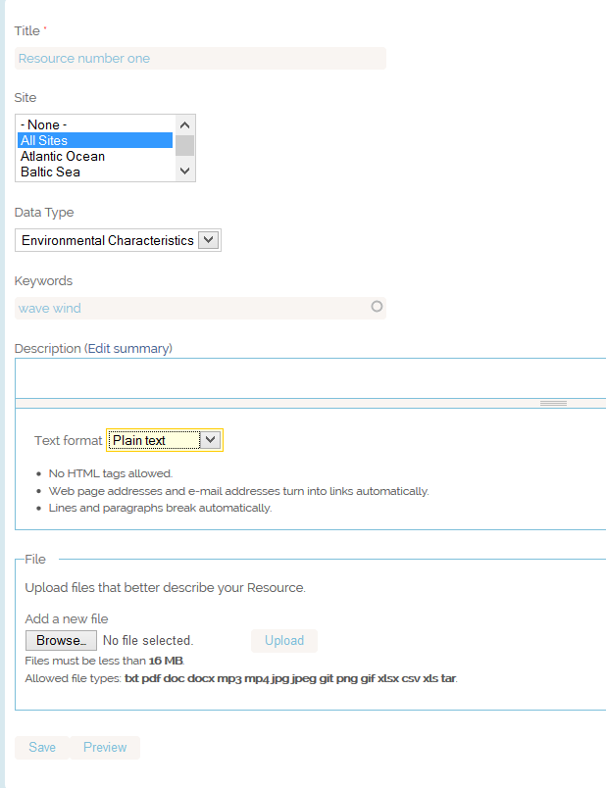
Workflow: Upload and describe your resource / dataset in dublin core metadata format.
mermaid.madgik.di.uoa.gr/content/add/resource
Add basic information about your resource.
Your resource will be displayed on the appropriate section of the repository according to this description.

Slide 13
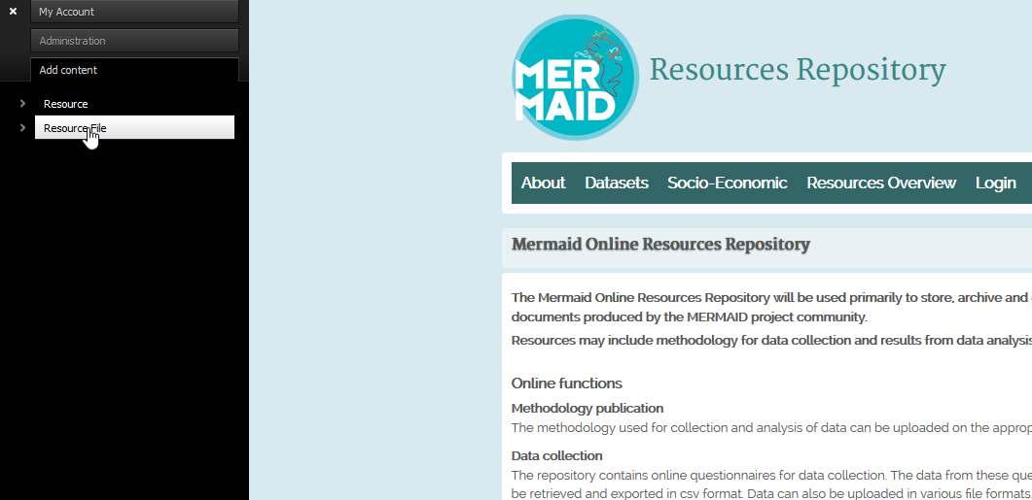
Workflow: Upload and describe your resource / dataset in dublin core metadata format.
Go to mermaid.madgik.di.uoa.gr/content/add/dataset-file

Slide 14
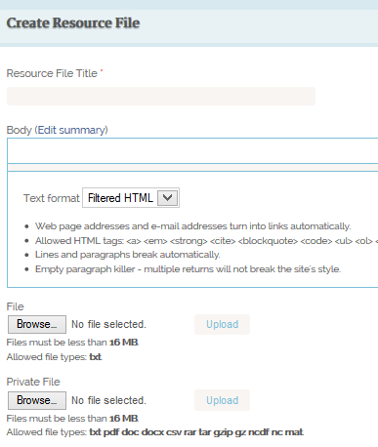
Workflow: Upload and describe your resource / dataset in dublin core metadata format.
mermaid.madgik.di.uoa.gr/content/add/dataset-file
Add basic information about your resource.
Your resource will be displayed on the appropriate section of the repository according to this description.

Slide 15
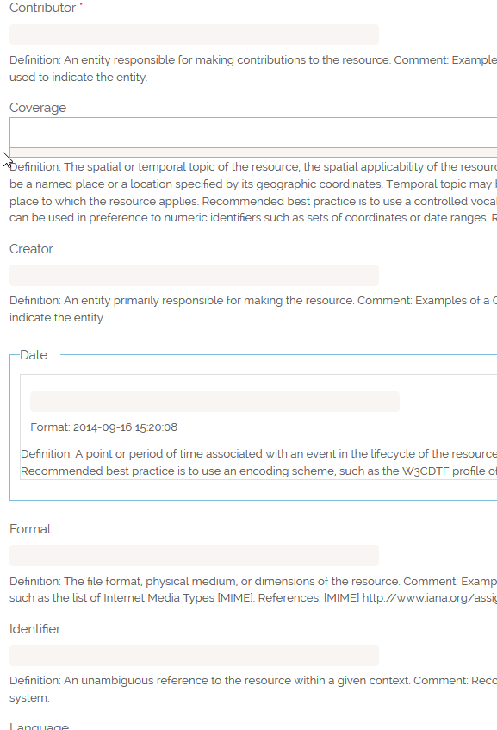
Workflow: Upload and describe your resource / dataset in dublin core metadata format.
mermaid.madgik.di.uoa.gr/content/add/dataset-file
Fill the fields following the instructions below each.
Your resource will be harvested by other portals according to these fields.
Upload your files using the Private File button – Visible only to registered users

Slide 16
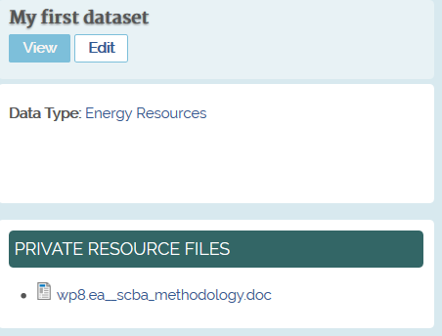
Functionality – Use Cases
Dataset with socio – economic data – private access
You locate it from the public version of the repository

Slide 17
Functionality – Use Cases
Dataset with socio – economic data – private access
You download it after you are logged in with your user account.

Slide 18
Get metadata
http://mermaid.madgik.di.uoa.gr/oai?verb=Identify
http://mermaid.madgik.di.uoa.gr/oai?verb=ListRecords&metadataPrefix=oai_dc

Slide 19
Conclusions
All partners: Need Restricted Access
Many partners publish selected results – Open Access
Our data should be compliant with the EU’s recommendation regarding resources (metadata harvesting – dublin core format)

Slide 20
Next Steps
Significant amount of data are generated specifically for the Mermaid Project. (More Data!)
Partners create accounts / use questionnaire to fill the missing information on Resources Overview table
Sections allocated for specific datasets - Database of meteorological and hydrological parameters in the study sites, regions and global sea level.
Policy recommendations (Sharing and re-use of the data (or metadata) of the participating resource providers.)

Slide 21
Thank you
Repository: http://mermaid.madgik.di.uoa.gr
Registration: http://mermaid.madgik.di.uoa.gr/user/register

