Slide 1
CBA and Risk Analysis Methodology
Anastasios Xepapadeas
Athens University of Economics and Business
MERMAID WP8, March 2014

Slide 2
The Economics Effects of a Project
They include benefits to:
  The owner/operator – private company
  Local, Regional, National, European economy
These benefits correspond to:
  Profits earned by a private company
  Direct effects on local, regional national economy (e.g., incomes, employment, trade balance)
  Indirect and induced effects (e.g., skills and knowledge spillovers)
  Environmental externalities

Slide 3
The Economics Effects of a Project
Countries should undertake investments which are efficient at the level of the national economy. Thus, it is necessary to evaluate how different investment projects affect the national economy, irrespective of whether ownership of the investment project is private or public.

Slide 4
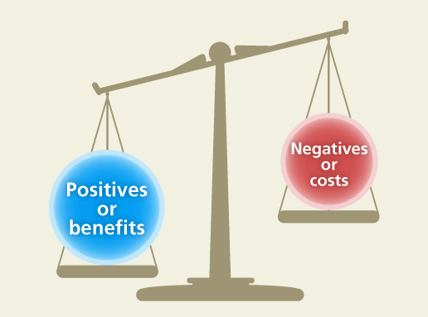
Cost Benefit Analysis
Cost-Benefit Analysis (CBA) is the methodology of analyzing a proposed investment project or determining whether undertaking it is in the public interest, or choosing between two or more mutually exclusive projects.
CBA assigns a monetary value to each input into, and each output resulting from, a project. The values of the inputs and outputs are then compared.
If the value of the benefits is greater than the value of the costs, the project is deemed worthwhile and should be executed.
Benefits and Costs include Direct, Indirect and Induced Effects
External costs and benefits are not captured by markets.
  Missing markets for environmental externalities
  Should be included in cost and benefits using, for example, nonmarket valuation

Slide 5
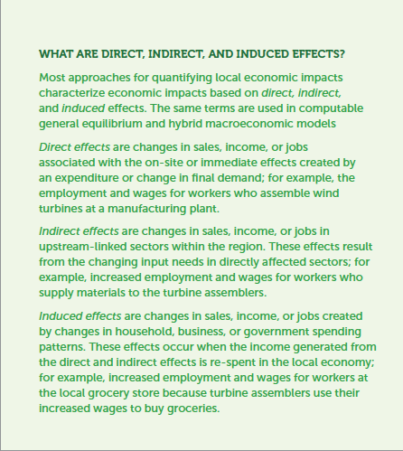
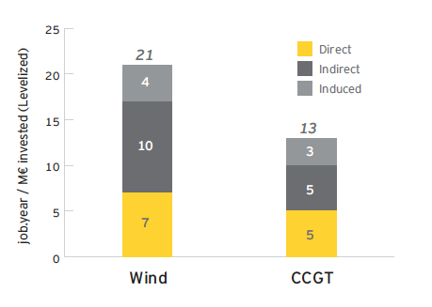
Jobs created by Wind and CCGT in EU27
Source: Ernst and Young, July 2012

Slide 6
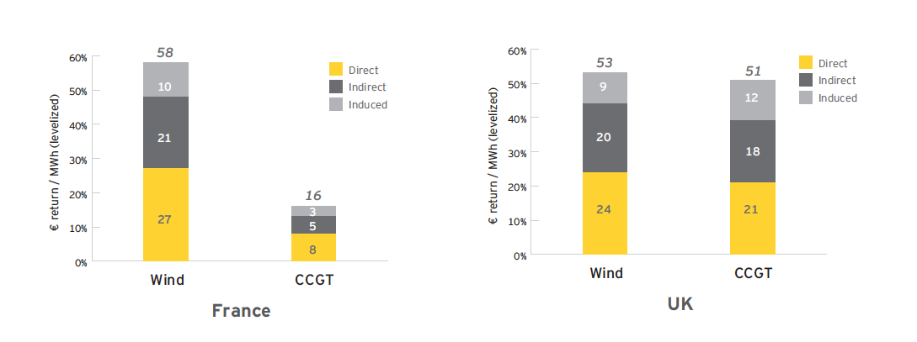
GDP creation from Wind and CCGT Energy in France and UK
Source: Ernst and Young, July 2012

Slide 7




Future Cash Flows
Project’s Life
Inflows and Outflows
R_{t}
Time
C_{t}
C₀
Inflows and outflows should include all direct, indirect,
induced, and external costs and benefits

Slide 8
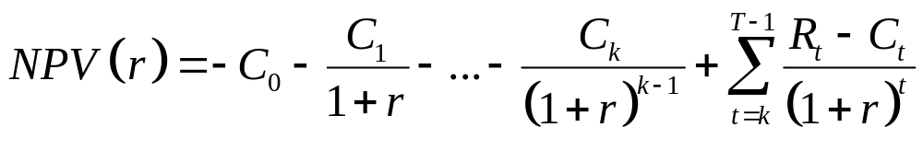
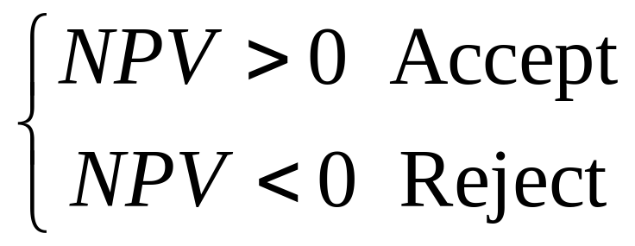
Evaluation Criteria
Net Present Value (NPV)
  C₀,…,C_{k}: Investment or Construction cost during construction period
  R_{t} -C_{t} (Revenues or Benefits less operating costs = Νet Cash-Flow)
  r: Discount rate - cost of capital or required rate of return

Slide 9
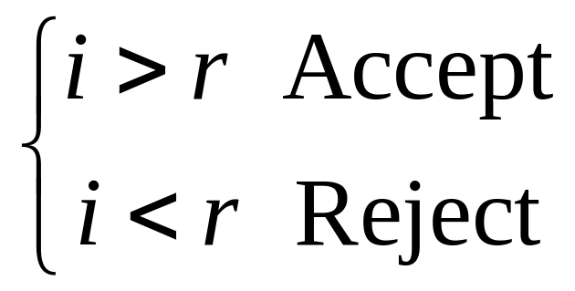
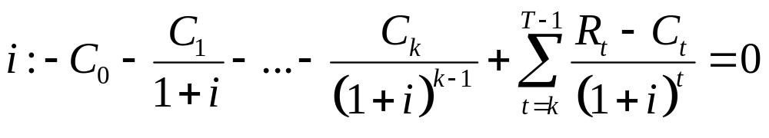
Evaluation Criteria
Internal Rate of Return (IRR)
The IRR is the maximum interest which can be paid on borrowed funds to finance the project when the project’s receipts are used to repay principal and interest.

Slide 10
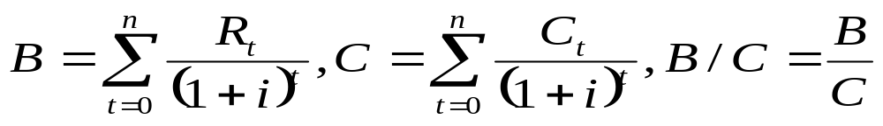
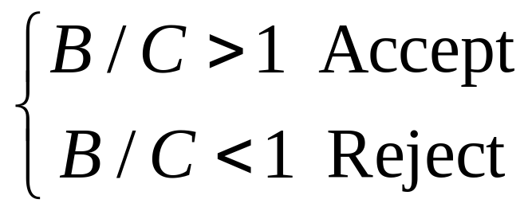
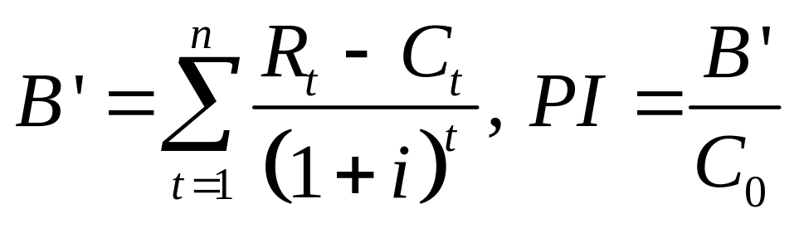
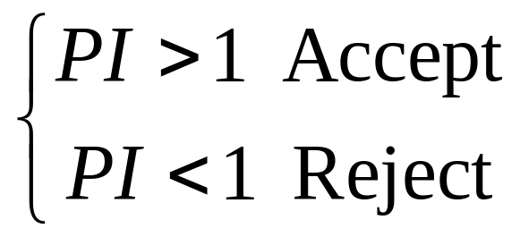
Evaluation Criteria
Benefit Cost Ratio (B/C)
Benefits per monetary unit of costs in present value terms
Profitability Index (PI)

Slide 11
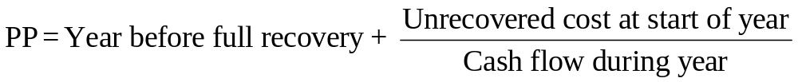
Evaluation Criteria
Payback Period (PP)
The payback period is defined as the expected number of years required to recover the original investment
It is the length of time taken to repay, from the project net cash flow, the initial investment cost

Slide 12
Steps in CBA: Financial Analysis
Evaluate the impact of the project at the level of a private investor
Value direct costs and benefits at market prices
  Cash inflows and outflows related to: total investment costs - total operating costs and revenues
Accept or reject decision based on the discounted cash flow approach (NPV, IRR, B/C, PI). The European Commission suggests a benchmark real financial discount rate of 5%.
Determine sources of finance and financial sustainability

Slide 13
Steps in CBA: Economic and Social Analysis
Requires an investigation of a project’s net impact on economic welfare for a country or a region.
This involves adjustment of cash flows valuated at market price at the stage of financial analysis and is done in six steps:
Observed market prices are converted - if necessary - into shadow or accounting prices that better reflect the social opportunity cost of the good.
Externalities are taken into account and given a monetary value.

Slide 14
Steps in CBA: Economic and Social Analysis
Indirect and induced effects are included if relevant (i.e., not already captured by shadow prices).
Intratemporal and intertemporal distributional weights are used - if needed - to adjust costs and benefits accruing to different income groups or different generations.
Costs and benefits are discounted with a real social discount rate (SDR).
Economic / Social performance indicators are estimated: NPV, IRR, B/C, PI.

Slide 15
Sample Costs and Benefits:
Offshore wind farm
Investment Costs
Turbines including transport and erection, Transformers and main cable to coast, Internal grid between turbines, Foundations, Environmental studies, Design and project management
Operating costs
Equipment, Maintenance, Labor cost, Vessels operating costs and maintenance

Slide 16
Sample Costs and Benefits:
Offshore wind farm
Benefits
Electricity sales (feed-in tariffs)
Fuel savings (conventional fuels)
Indirect and induced benefits (upstream effects, tourism income and employment in local communities, etc.)
Environmental Costs and Benefits
CO2 reduction (value of CO2 reduction)
Noise and visual
Effects on marine ecosystems
Decommissioning environmental costs

Slide 17
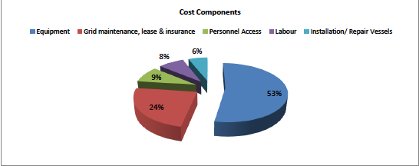
An example: An offshore wind farm in Greece
Investment costs ≈ 180 million Euros

Slide 18
Performance criteria
Financial NPV
  141.1 mil€ @3%
  89.6 mil€ @5%
  7.8 mil€ @10%
Financial IRR 10.7%
Economic NPV 340.9 mil€. Including lignite fuel saving and benefits from CO2 reductions. Social discount rate @4% using the Ramsey rule.
Economic IRR 23%
Economic B/C Ratio 3.95

Slide 19
Risk analysis
Risk analysis or risk assessment in cost benefit analysis aim to address uncertainty associated with the future cash flows of a project.
In risk analysis the ‘stand alone’ risk for the project is analyzed. Stand alone risk represents measurable uncertainty which is the case where a known probability measure is associated with stochastic variables.
Accounting for risk requires therefore an assessment of probability distributions indicating the likelihood of the realized value of a variable falling within stated limits.

Slide 20
Methods: Sensitivity analysis
Sensitivity analysis is a technique that indicates how much the NPV, the IRR or the B/C ratio will change in response to a given change in variables that affect the cash flow of the project, other things held constant. It involves the following steps:
Define a base-case or benchmark estimation of the NPV, IRR, or B/C using the expected values for each variable involved in the cash flow.
Identify sensitive or critical variables for which a small deviation of their values from the benchmark value will change the NPV, IRR, or B/C a lot.
Construct a sensitivity diagram.

Slide 21
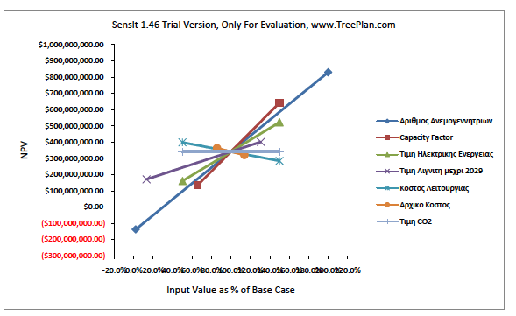
Sensitivity analysis
Number of wind turbines
Capacity factor
Feed-in tariff
Lignite price
Operating costs
Investment costs
Imputed CO2 value

Slide 22
Sensitivity Analysis

Slide 23
Monte Carlo Simulations
The Monte Carlo method is a computational algorithm which is based on random sampling. To use the method the analyst needs to assign specific subjective probability distributions (e.g., uniform, triangular, normal) to important cash flow variables. It proceeds in the following steps:
A value of a variable is selected from its distribution using a random number generator.
A vector of specific values is defined (e.g. unit labor cost , capacity factor, feed-in tariffs).
These value are used to calculate an NPV, an IRR or a B/C ratio which are stored for this replication.

Slide 24
Monte Carlo Simulations
After a large number of replications (500-1000), a frequency distribution is estimated for the NPV and/or the IRR.
Making the normality assumption, the estimated distribution can be used to construct confidence intervals and perform hypothesis testing.

Slide 25
Monte Carlo: NPV Histogram 1000 replications

Slide 26
Monte Carlo: Cumulative NPV 1000 replications

Slide 27
Value at Risk (VAR)
The value at risk (VAR) of an investment is the value v such that there is only a 1% chance that the loss from the investment will be greater than v. Because −NPV is the loss, the value at risk is the value v such that
Pr [−NPV > v] = 0.01
The VAR criterion for choosing among different investments, which selects the investment having the smallest VAR, has become popular in recent years.

Slide 28
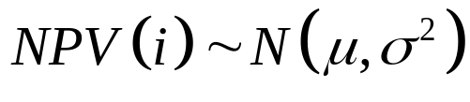

Value at Risk
Let
Then
Consequently, among investments whose gains are normally distributed, the VAR criterion would select the one having the largest value of μ − 2.33σ.

