Slide 1
Research Department Work Plan 2024
Peter Landschützer

Slide 2
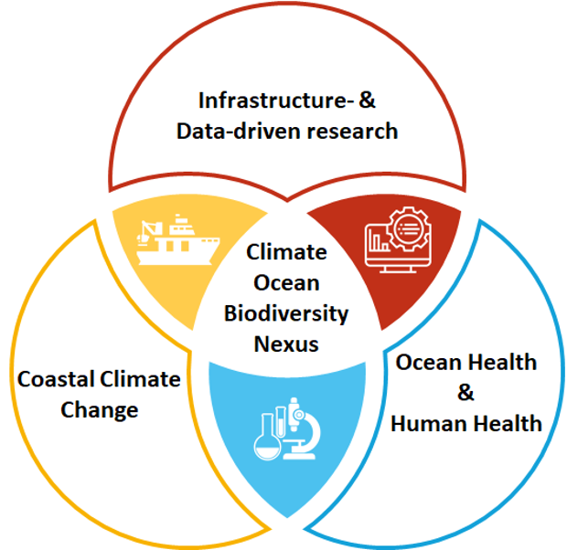
RECAP: Our research mission

Slide 3
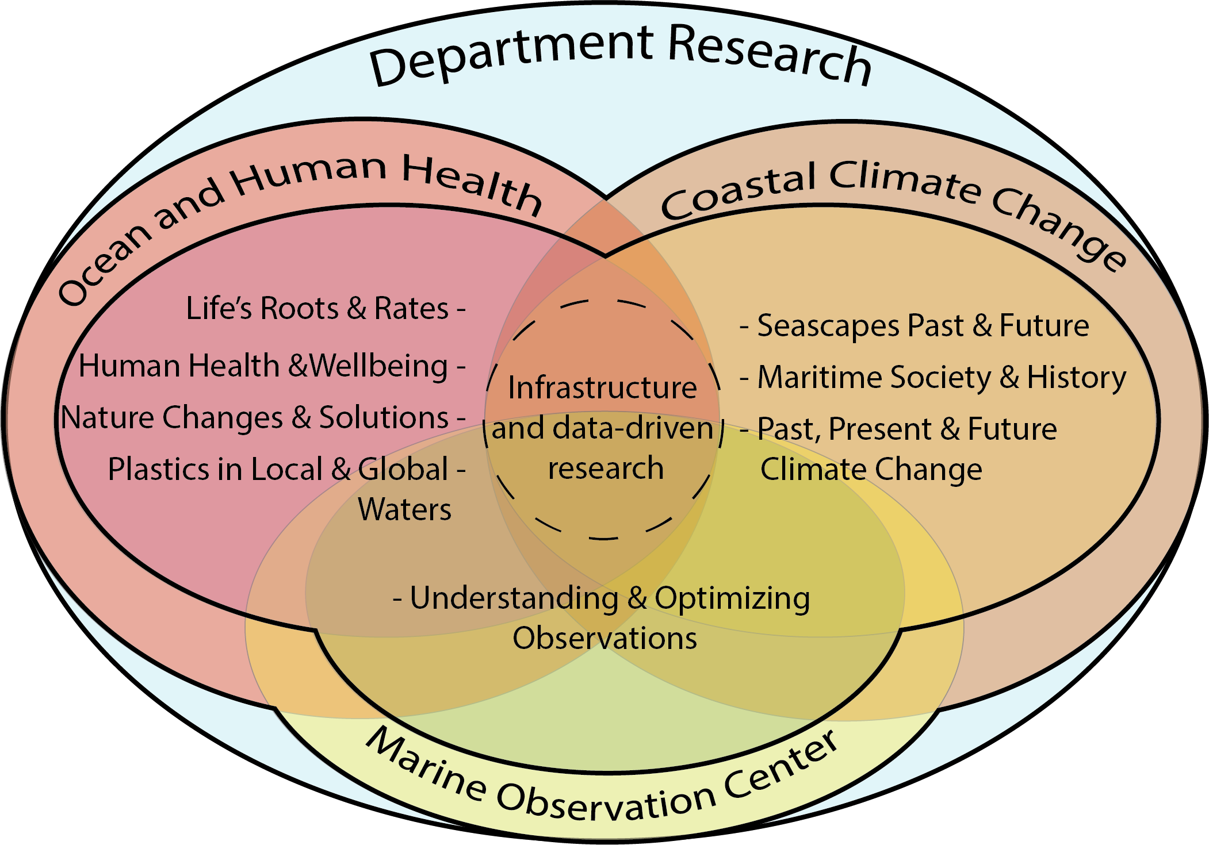
Retrospect 2023 – Department structure
From
To
Department Research
and MOC
- Ocean & Human Health
- Life’s Roots & Rates
- Nature Changes & Solutions
- Seascapes Past & Future
- Maritime Society & History
- Understanding & Optimizing
Observations

Slide 4
Retrospect 2023 – Department structure
Group leaders:
Dr. Gert Everaert*
Dr Maarten De Rijcke
Klaas Deneudt*
Dr Pascal Hablützel
Dr Tine Missiaen
Dr Torsten Feys
Dr Ana Catarino
Dr Peter Landschützer*
* Heads of Divisions OHH, CCC, MOC
MOC PI topics: Underwater sound and bio-acoustics (Dr. Elisabeth Debuschere)
Animal movement and behavioral ecology (Dr Jan Reubens)

Slide 5
Retrospect – 2023, a year in numbers:
62 projects/activities (internal and external) in 2023 distributed throughout all research groups
We had collaborations with all Flemish Universities and many national and international partners
3 VLIZ research group leaders serve as as guest professors
VLIZ researchers were involved in several research highlights
Leadership
Impact
Visibility
Outreach & Networking

Slide 6
Highlights 2023: New Projects and Leadership
Launch of the DTO Bioflow and INSPIRE projects
DTO-BioFlow is composed of 32 participants (VLIZ coordinates, 42M, 10 M€)
INSPIRE is composed of 26 partners (VLIZ coordinates, 48M, 10 M€)
Beyond Submerged Landscapes – defining human response to postglacial sea-level rise and climate change (SUBNORDICA) is awarded an ERC synergy grant.

Slide 7
Highlights 2023: Impact
North Sea Wrecks: “80 years later: Marine sediments still influenced by an old war ship“ – led by UGENT
148 news stories,
56 original articles /
translations,
31 references to NSW,
22 countries,
14 languages
VLIZ is taking a leading role (core team) of the Global Carbon Budget (release date is December 5th)

Slide 8
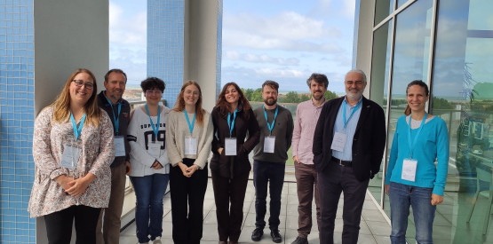
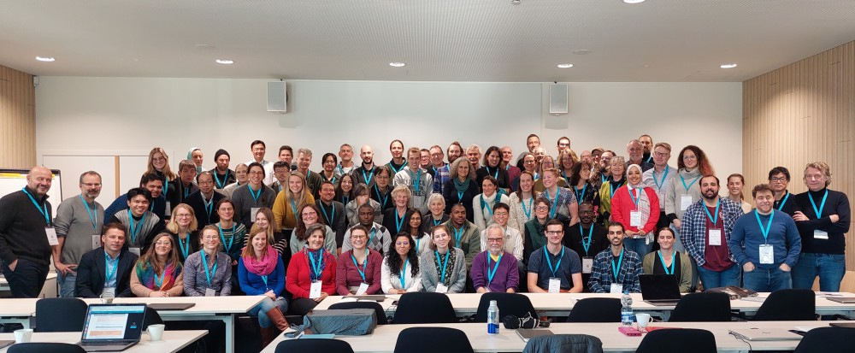
Highlights 2023: Visibility
VLIZ events
Workshop ‘Hotels and the Registration of Travelers, Migrants and Tourists’
ANERIS Workshop on Genomic Technologies was organized by VLIZ
ICOS/GCB/SOCAT/SOCONET workshop with 100+ participants
Kick-off events for DTO BioFlow and INSPIRE
Ostend working group on Ocean and Human Health

Slide 9
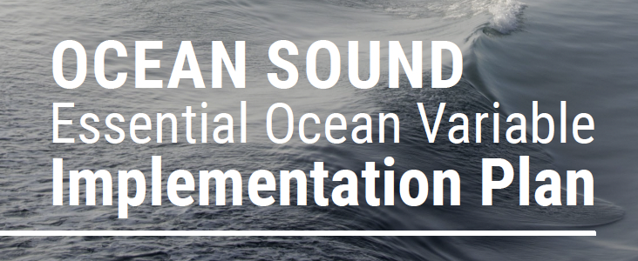
Highlights 2023: Outreach and Networking
Policy Briefs on Blue Carbon and Carbon Accounting
COST long read: exploring the oceans with the European Tracking Network
Ocean Sound EOV Implementation Plan
Contribution to: Feasibility of eradication and spread limitation for species of Union concern sensu the EU IAS Regulation (EU 1143/2014) in Belgium

Slide 10
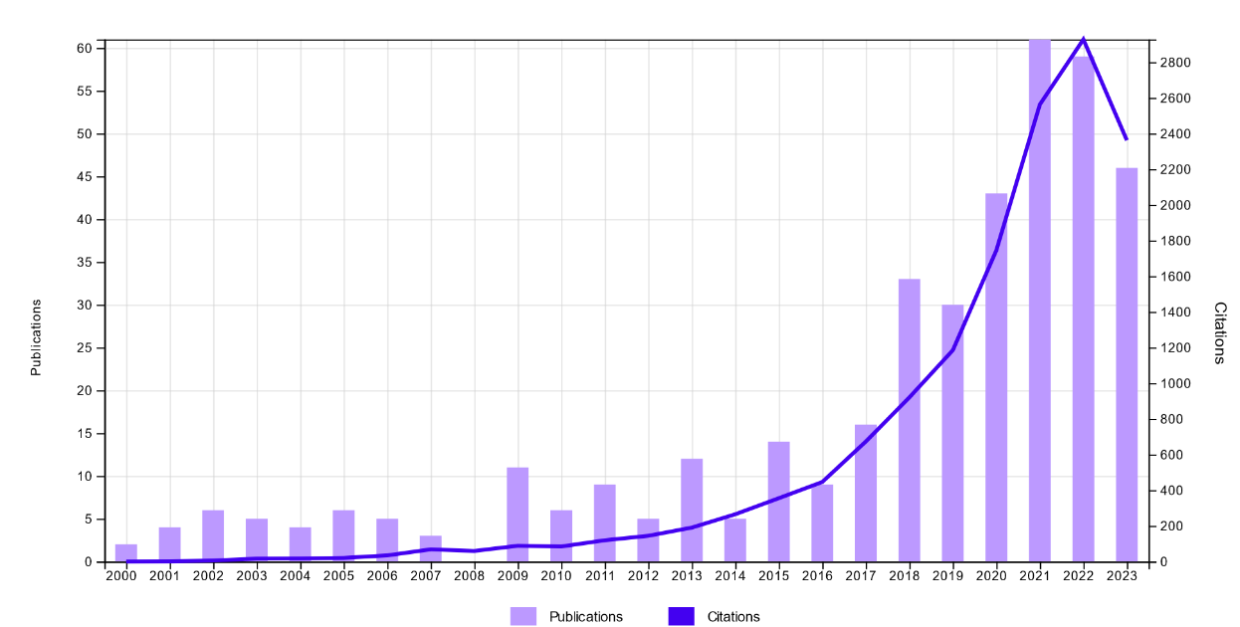
Retrospect 2023 - a year in numbers (Web of Science 9.11.2023)
Start of VLIZ research

Slide 11
Retrospect 2023 - a year in numbers:
Reporting year | Number of Publications (A1) | Open access (A1) | Percentage OA (A1) | Total VLIZ A1 citations
2022 | 125 (51) | 104 (38) | 83% (75%) | 11 297
2023 | 184 (63) | 172 (57) | 93% (90%) | 14 296
Difference 2022 vs 2023 | +59 (+12) | +68 (+19) | +10% (+15%) | +2 999
(*) numbers from 9.11.2023

Slide 12
Retrospect 2023 - a year in numbers:
Reporting year | Number of Publications (A1) | Open access (A1) | Percentage OA (A1) | Total VLIZ A1 citations
2022 | 125 (51) | 104 (38) | 83% (75%) | 11 297
2023 | 184 (63) | 172 (57) | 93% (90%) | 14 296
Difference 2022 vs 2023 | +59 (+12) | +68 (+19) | +10% (+15%) | +2 999
(*) numbers from 9.11.2023

Slide 13
2024 – a year in planning

Slide 14
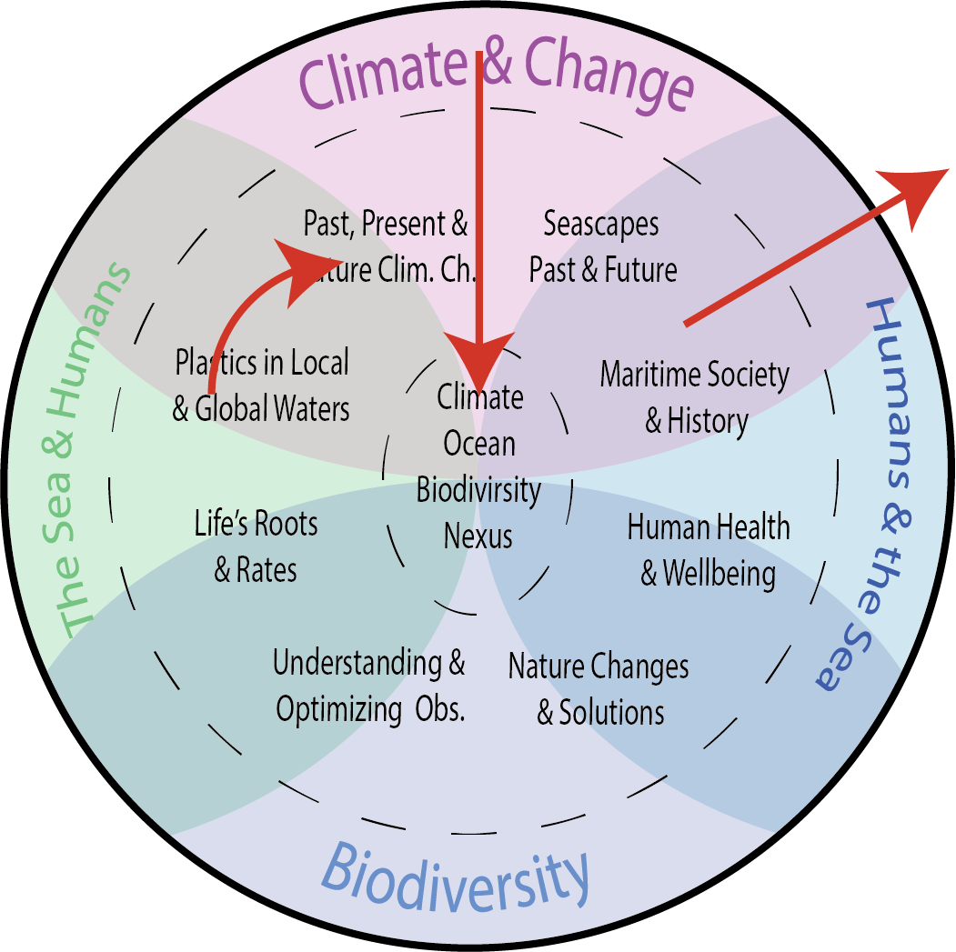
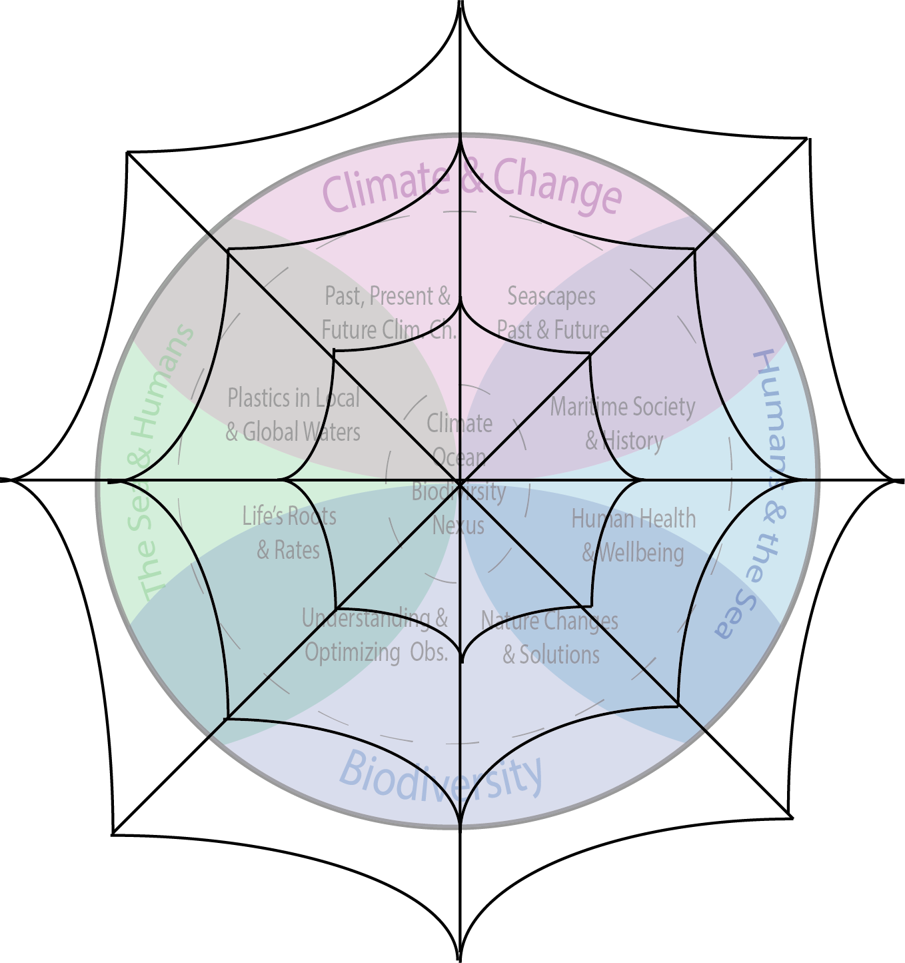
2024 – a year in planning – role of PhD´s
Knowledge Network (co-)sustained by “PhD Web”
within VLIZ and our University partners
Essential information flow to study the Nexus
Topical knowledge transfer
VLIZ Infrastructure
External partners
Cross-group transfer
PhD
PhD
PhD
PhD
Research centres
Universities
PhD
PhD
PhD
PhD
Marine Robotics

Slide 15
2024 – a year in planning
First VLIZ PhD´s will graduate in 2024
We would already like to thank all University promotors for the collaboration over the past years
And many thanks to our PhD´s for building this network
Hope to recruit the 2nd generation of PhD students in 2024 (around autumn 2024)
Topics will follow the groups core topics, with a strong focus on:
Maintaining the successful collaboration with Universities in Flanders
Making use of our new facilities and infrastructure
Linking research group topics
Overall supporting the VLIZ network (or “PhD web”)

Slide 16
2024 - a year in numbers:
66 projects/activities (internal and external) listed in the 2024 department workplan
All Flemish Universities are listed as partners in the 2024 workplan
> 50 international partners are named in the 2024 workplan
VLIZ research in (inter-)national leading roles
Research staff expenses are balanced by external project funding

Slide 17
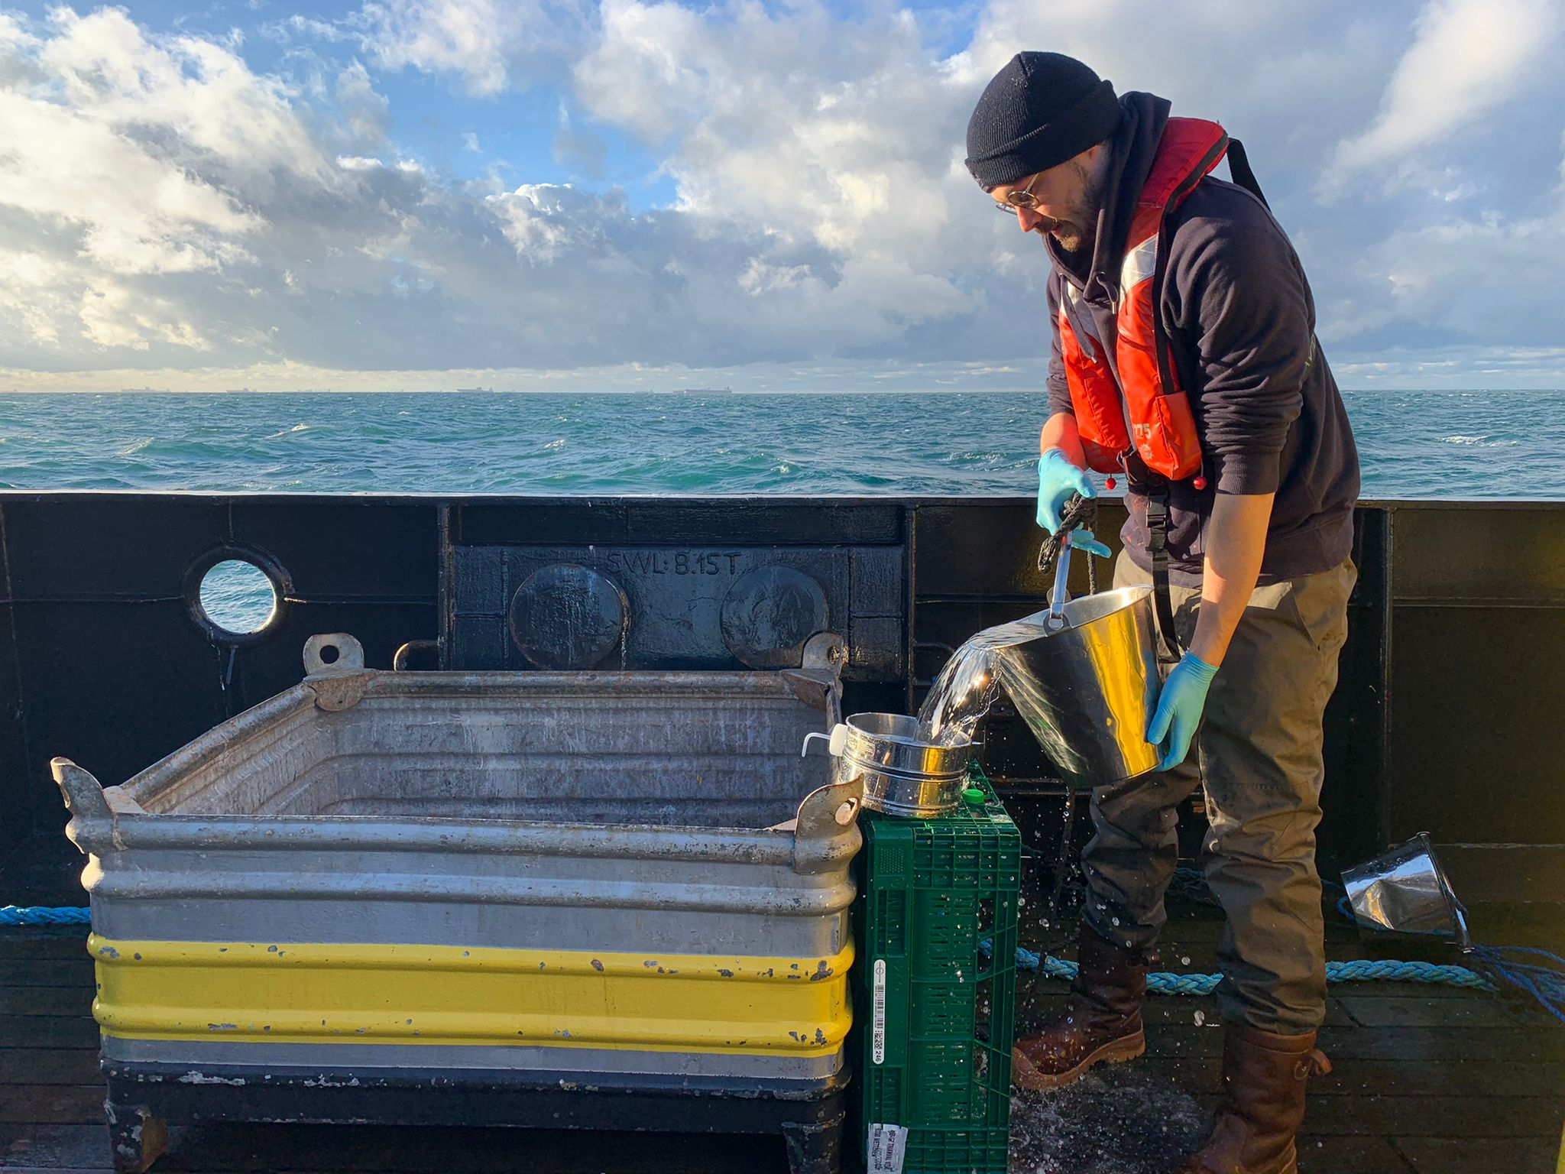
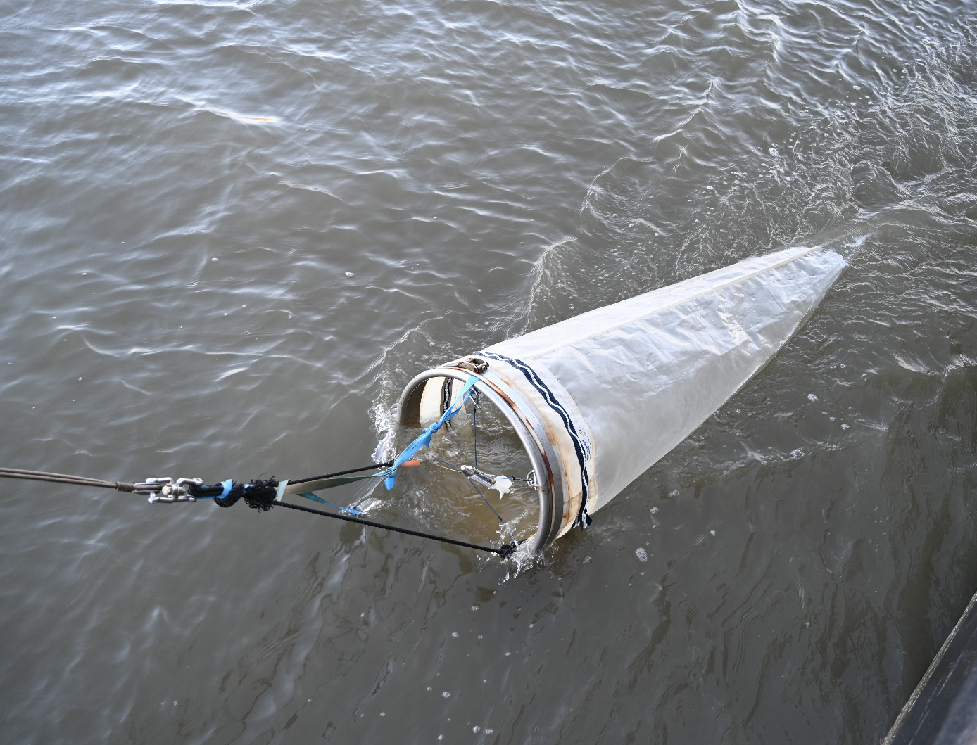
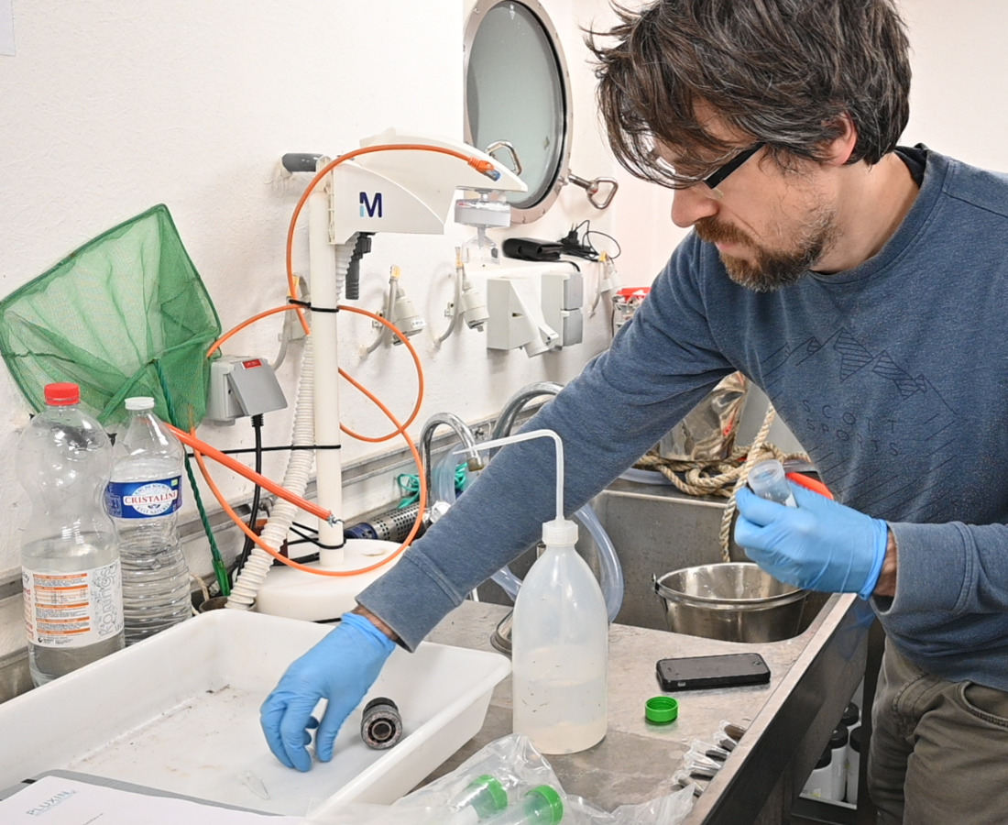
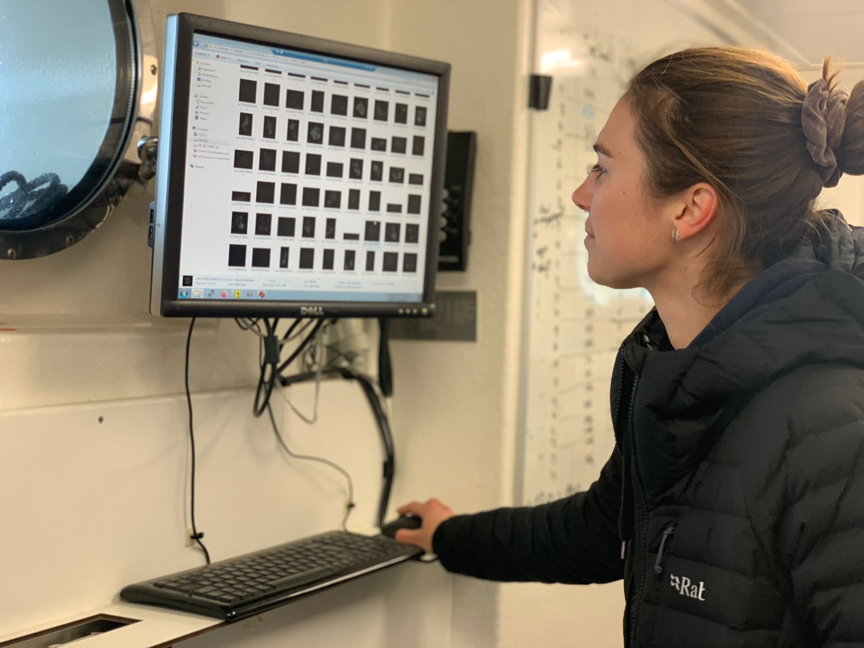
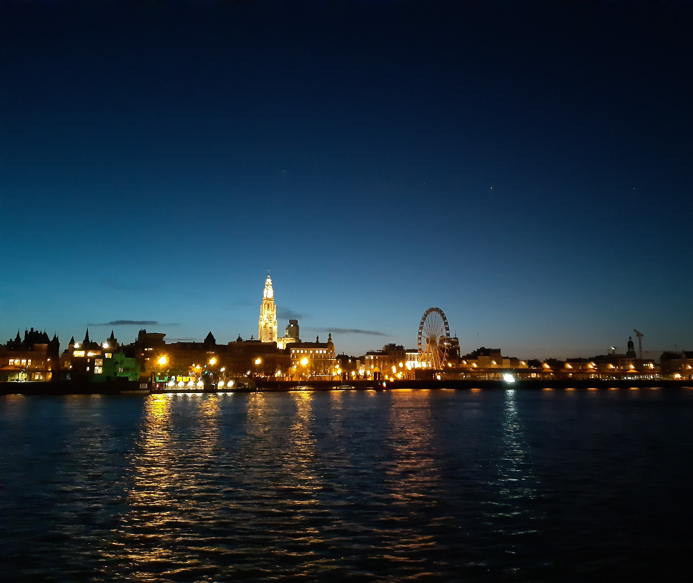
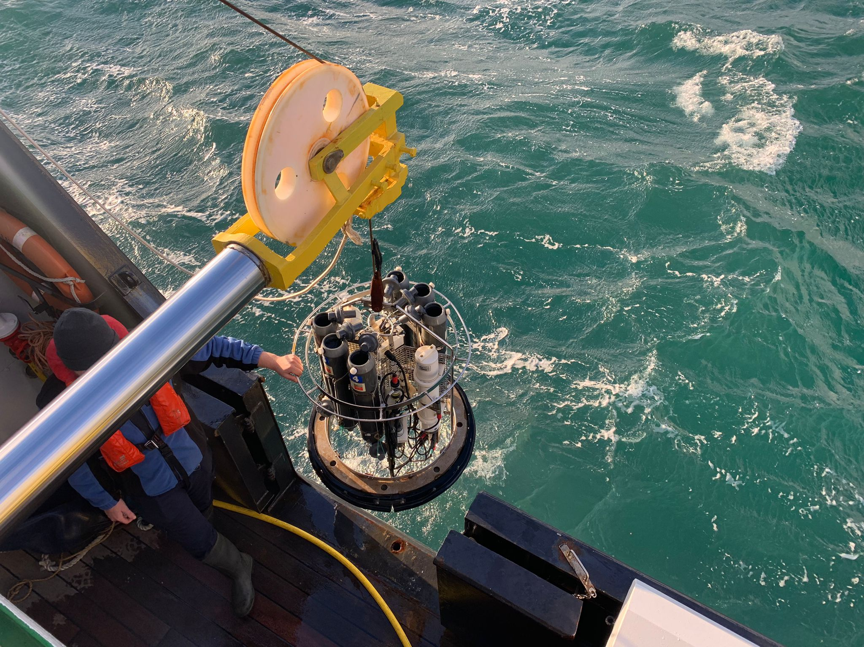
Thank You

